Slide 1
Immunization Advocacy
Stephan L. Foster, Pharm.D., FAPhA
Liaison Member, Advisory Committee on Immunization Practices
CAPT(Ret), U.S. Public Health Service
Professor (Ret), University of Tennessee College of Pharmacy

Slide 2
Learning Objectives
At the end of this session, the active participant will:
1. Describe methods of increasing vaccination rates
2. Understand why some patients/parents are hesitant to receive vaccines
3. Describe methods to encourage providers to increase vaccination recommendations.

Slide 3
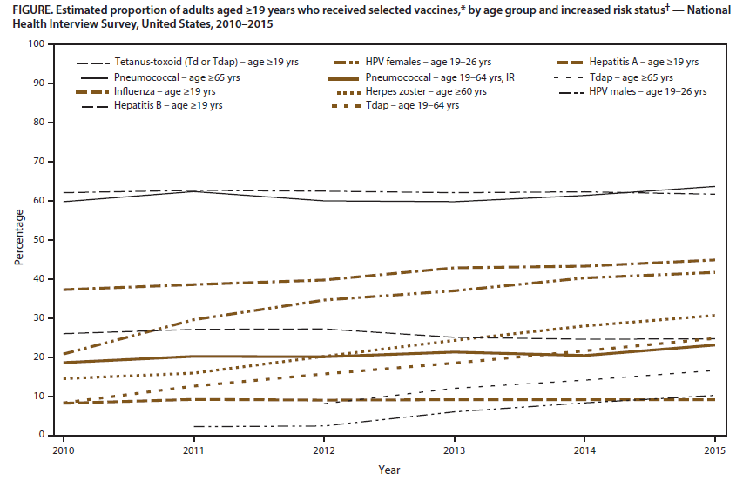
Surveillance of Vaccination Coverage Among Adult Populations – U.S., 2015
CDC, MMWR 2017;66(11) 1-32, Accessible at https://www.cdc.gov/mmwr/volumes/66/ss/ss6611a1.htm

Slide 4
Pharmacist Administered Influenza Vaccine
Study using prescription database and BFRSS 2007-2013
Results
Number vaccinations increased from 3.2 million to 20.9 million
No significant difference in adult vaccination rates
No observed difference in high-risk adult vaccination rates
Conclusion
“…we do not observe substantial increases in adult immunizations vaccination rates……which suggest that most of the people vaccinated by pharmacists would have been vaccinated anyway. The main benefit…a more convenient and flexible way to obtain an important health service”
McConeghy KW, Wing C. A national examination of pharmacy-based immunization statutes and their association with influenza vaccinations and preventive health. Vaccine 2016;34:3463-3468

Slide 5
Comparison of Adult Vaccination Assessments Reported by HCPs and Pharmacists, and General Adult Populations, United States, 2016

Slide 6
Standards of Practice
All HCP, whether they provide vaccinations or not, take steps to ensure that their adult patients are fully immunized
ASSESS immunization status at all encounters
Strongly RECOMMEND vaccines that are needed
ADMINISTER or REFER
DOCUMENT

Slide 7
Why do you think patients/parents refuse or delay vaccines?

Slide 8
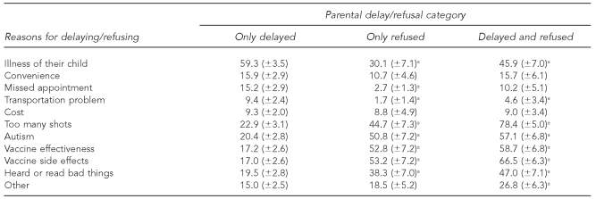
Reasons patient delay or refuse vaccinations
Smith PJ, Humiston SG, Marcuse EK,et al. Parenteral Dely or refusal of vaccine doses., childhood vaccination coverate at 24 months of age and the health belief model. Public Health Rep. 2011;126(Suppl 2):135-146

Slide 9
Flu Excuses
I got the flu from the flu shot
I never get the flu
It’s too late in the season
I do not like shots
Vaccine does not work
Only old people die from the flu
I can take Echinacea, vitamin C, ……
Flu is not a serious disease
I am not at risk for flu
I had the vaccine last year and got the flu
I don’t believe in the flu vaccine
If I have symptoms, I will stay home and not spread it.
Vaccine is not safe
The government_______________
It weakens my immune system
I am on _____ medicine and should not get the vaccine
Vaccine strengthens the virus

Slide 10
Some Explanations Behind the Excuses
Perceived Risk
False Beliefs
Overwhelmed/Do not understand
Can control child’s susceptibility
Unreliable vaccine information and negative media
Prefer inactivity to negative outcomes
Herd Immunity
Alternate Medical Beliefs
Direct experience with adverse effects
Provider attitudes

Slide 11
Predictors of Change
Importance
Confidence in product
Rapport with provider

Slide 12
Patient Centered Care
Understand biomedical, social, and psychological factors relating to illness
Perceive the patient as a person and they have the right to decide - Respect
Individualized care
Involve patients in decision making – shared decision
Be aware of your own response and unintended behaviors
Show you care
“Patients do not care how much you know until they know how much you care”

Slide 13
Motivational Interviewing
Open-ended questions
Reflective Listening
Do not reinforce resistance talk
“Sounds like you may consider vaccination if it did not cause the flu.”
Affirmation of positive statements
“I am pretty sure if you were convinced the needle does not cause pain, you would consider getting the vaccination.”
Normalization and Empathy
“A lot of people feel the same way that you do”
Ask for patient’s response
Accept patient’s decision
Ask to revisit the issue if negative response

Slide 14
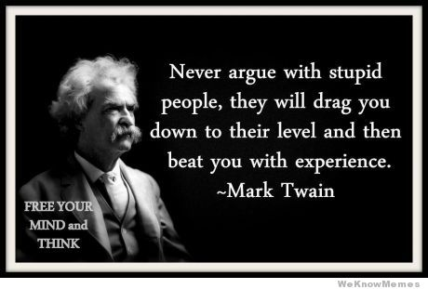
Do Not Argue

Slide 15
If you were in charge, what would you suggest to increase vaccine rates where you work?
This is a mandate from above!

Slide 16
Healthcare System Methods to Increase Rates
Quotas
Target High-risk patients
Quality Improvement Programs
Reminder systems (Computerized)
Standing Orders
Easy Access
Education
Encourage strong recommendation from providers
Develop an Immunization Champion or Team

Slide 17
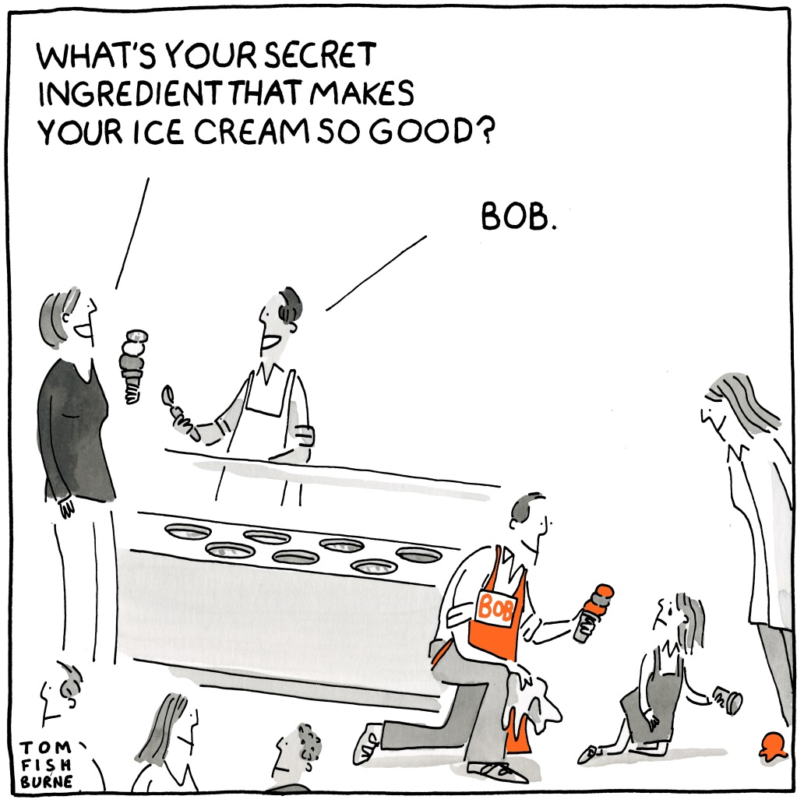

Slide 18
Traits of an Advocate
Want to get involved
Good at talking to people
Appreciate subtle distinctions when talking to patients
Great source of information/knowledgeable
Detail oriented
Show they care
Realize it takes extra effort
May help them create a new job

Slide 19
Persuasiveness
“If you want, you can get your pneumococcal vaccine here today.”
or
“I strongly recommend you get your pneumococcal vaccine today to help prevent a very serious disease for which you may be at risk.”

Slide 20
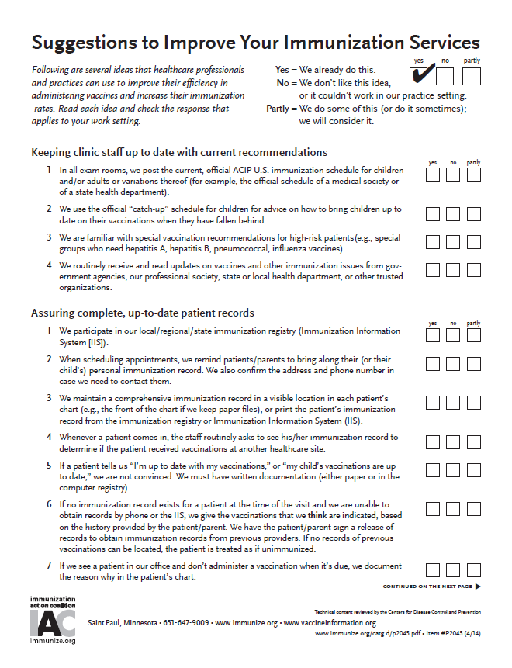
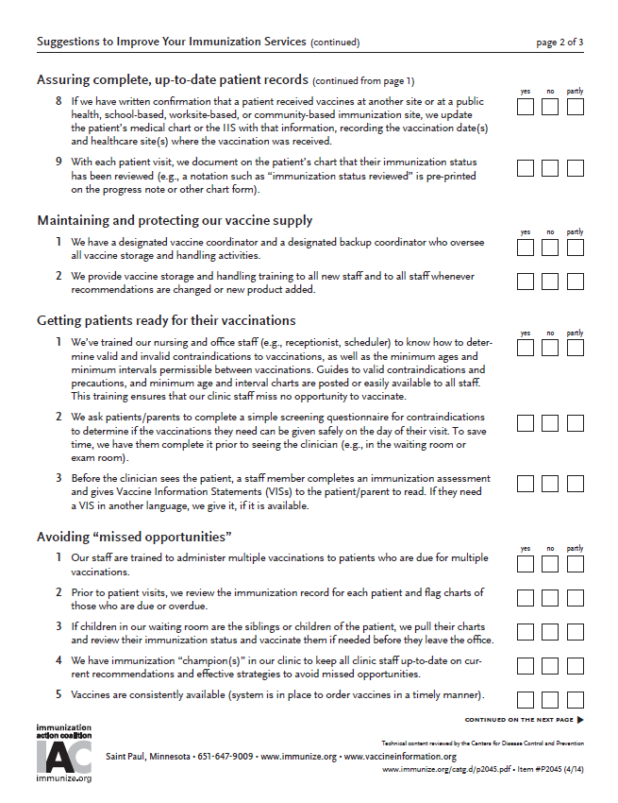
Checklist available at immunize.org
www.immunize.org/catg.d/p2045.pdf

Slide 21
Governmental Methods to Increase Rates
Requirements for school entry
Requirements for travel
Eliminating personal exemptions
Subsidizing cost for vaccines
Vaccination campaigns
Patient Education/Awareness
Research/ Monitoring
OSHA Standard (hepatitis B vaccine)

Slide 22
Business Methods to Increase Vaccination Rates
Employment Requirements
Paying for vaccines
Hold immunization clinics on site
Partnership with Healthcare organizations

Slide 23
Things pharmacist would like to tell patients
We are human
We study more about drugs than any other profession
All pharmacists are not equal
We will save you money if we can
Drive-thru windows are not good
The more I know about you, the more I can help
Don’t try to get things past us
When in doubt, please ask
Use one pharmacy
We are busy and filling more prescriptions than ever
Yelling won’t help
We have laws we have to follow
We hate your insurance companies as much as you
People take too many drugs
Electronic Prescriptions are not instant
High-cost care is not lining my pockets
Consider paying with cash
The internet is not always right
We never get to talk to the doctor

Slide 24
Wrong Question For Patients
Do not ask!
Do you have any questions for the Dr, nurse, pharmacist?
Do you have any questions?

Slide 25
You are in charge of an organization with many employees. You have decided to make your business/ healthcare system become a leader in vaccinations. Your employees will do as little as possible toward your goal. How are you going to deal with your providers to increase vaccination rates?
Case Discussion

Slide 26
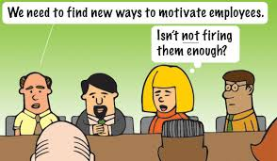

Slide 27
Encouraging Providers
Work on yourself first
Be passionate
Create supportive environment
Make time for your employees
Listen to emotions, not just problems
Stop problem employees from dictation culture
Discover ways to have fun
Follow through promptly
Create attainable goals
Hold discussions with employees
Offsite
Remind what purpose is
Be clear on everyone’s role
Involve them by sharing ideas
Know your employees

Slide 28
Encouraging Providers
Start slow and work up to goals
Good today is better than perfect tomorrow
Help them see their progress
Understand what you are working for
Help them find meaning in their work
Tell them the truth
Find out what motivates employee
Recognize hard work
Reward systems
Have a patient tell them what they need

Slide 30
Do or Do Not. There is no try! Lead by example

Slide 31
Questions? Comments? Concerns? Complaints? Any Feedback!

