Slide 1
Vaccination Rates in Idaho: Updates Fall 2017
Christine Hahn, MD
Idaho Division of Public Health
IDHW

Slide 2
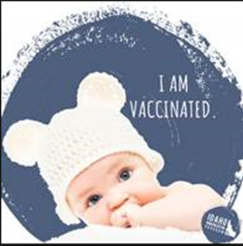
What new vaccination rate data is available?
National 2016-2017 influenza vaccine coverage estimates (released at June 21, 2017 ACIP meeting)
National and state teen vaccination rates (released in MMWR on August 25, 2017)
Tdap
Meningococcal ACWY
HPV
County-level data from the Idaho Immunization Program
hepatitis HPV coverage (presented in Feb 2017)
hepatitis B birth dose
teen meningococcal vaccine coverage

Slide 3
Influenza: how were national vaccination rates last season?
Concern that rates would drop due to lack of FluMist
Source: Eastern Idaho Public Health

Slide 4
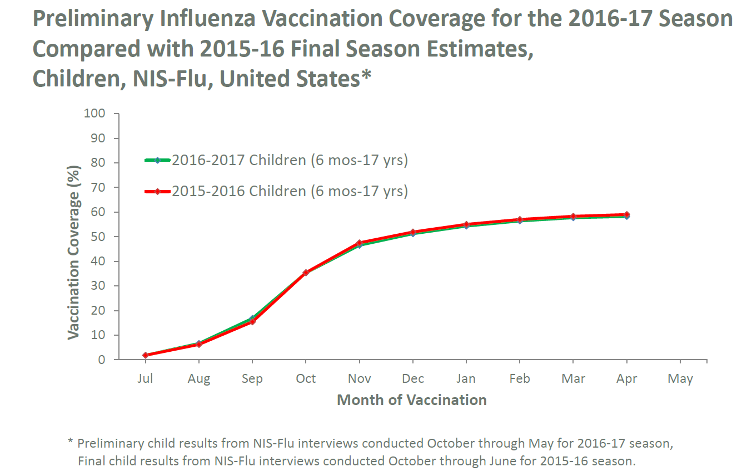
Notes:
Immunization Services Division, CDC
Coverage remained similar

Slide 5
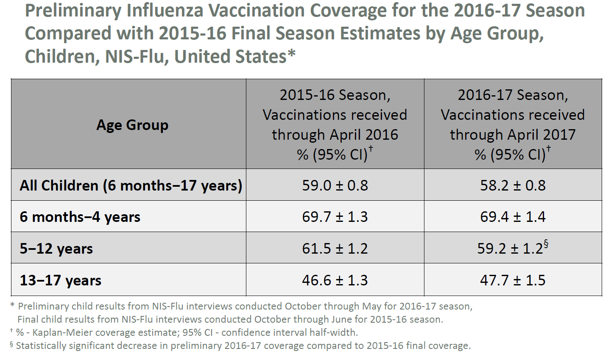
Source: Grohskopf, ACIP Presentation, June 21, 2017
Notes:
Similar between the two seasons
Coverage estimates were similar between the two seasons overall
By age: lower in 5-12 year olds: 2.3% lower, significantly different

Slide 6
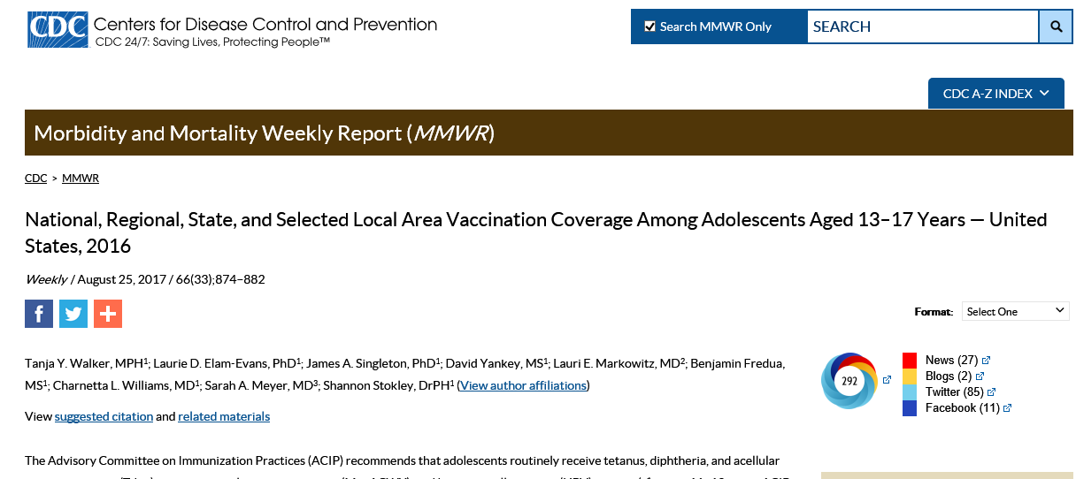
Idaho Teen Immunization Rates
2016 Teen National Immunization Survey results released August 2017

Slide 7
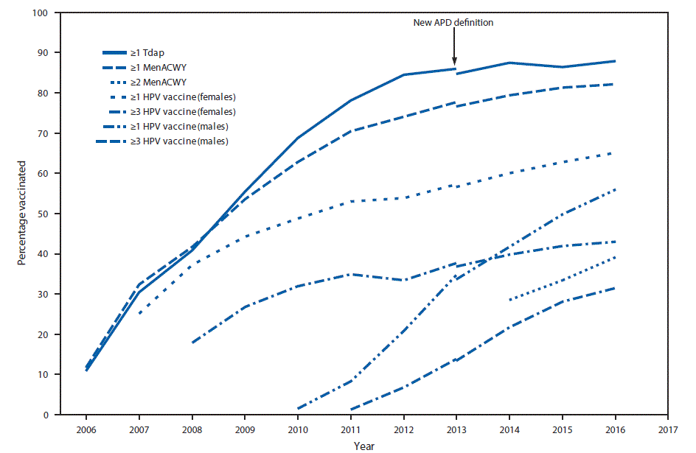
Estimated vaccination coverage with selected vaccines and doses among adolescents aged 13–17 years, by survey year — National Immunization Survey–Teen U.S., 2006–2016
Tdap 88.0%
≥1MenACWY
≥1 HPV (F)
≥1 HPV (M)
≥3 HPV (F)
≥2MenACWY
≥3 HPV (M)

Slide 8
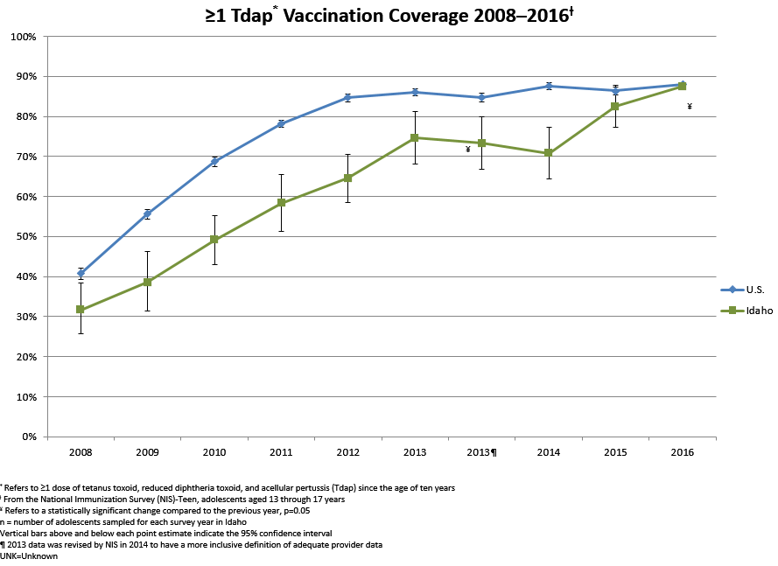
87.5%

Slide 9
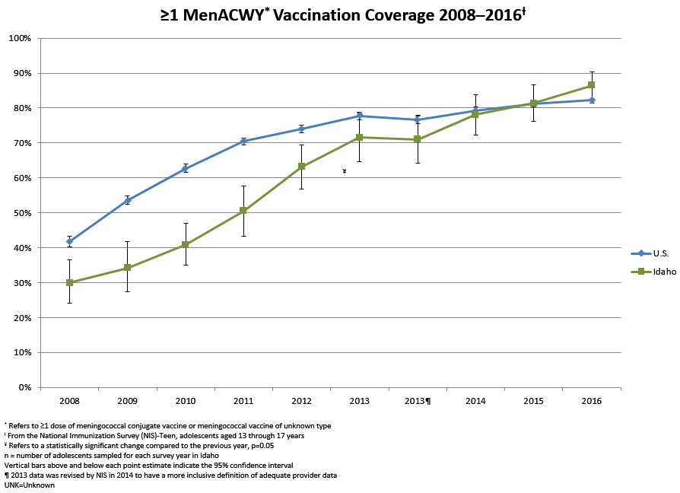
86.5%

Slide 10
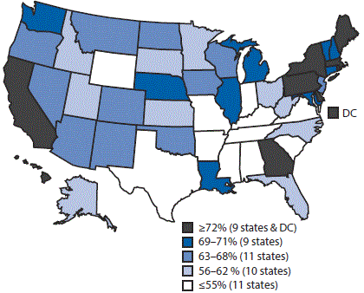
Estimated vaccination coverage of ≥1 dose of HPV among female adolescents aged 13–17 years —NIS–Teen, U.S., 2016
U.S.: 65.1%

Slide 11
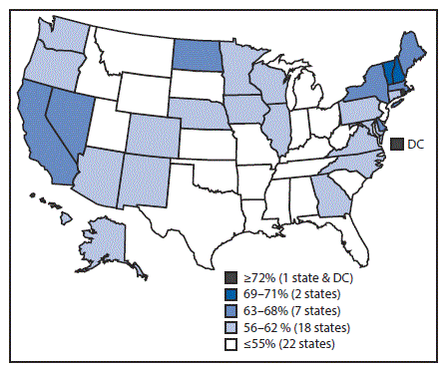
FIGURE 3. Estimated vaccination coverage of ≥1 dose of HPV among male adolescents aged 13–17 years— NIS–Teen, U.S., 2016
54.7
U.S.: 56.0%

Slide 12
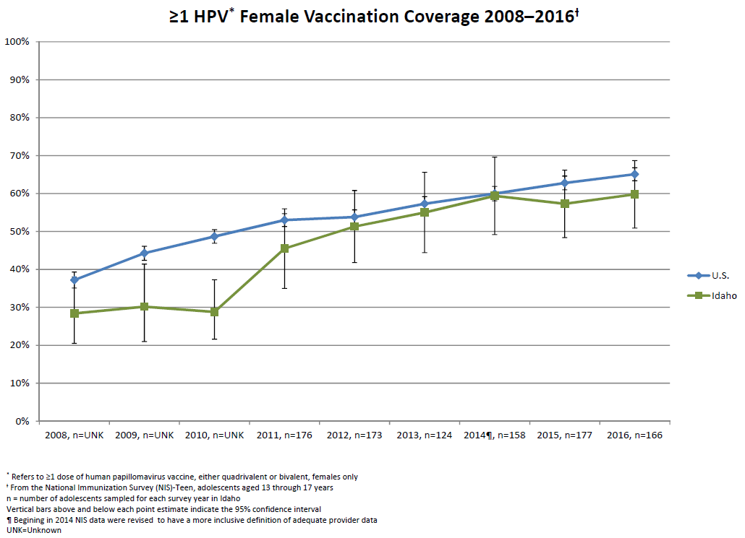
59.8%

Slide 13
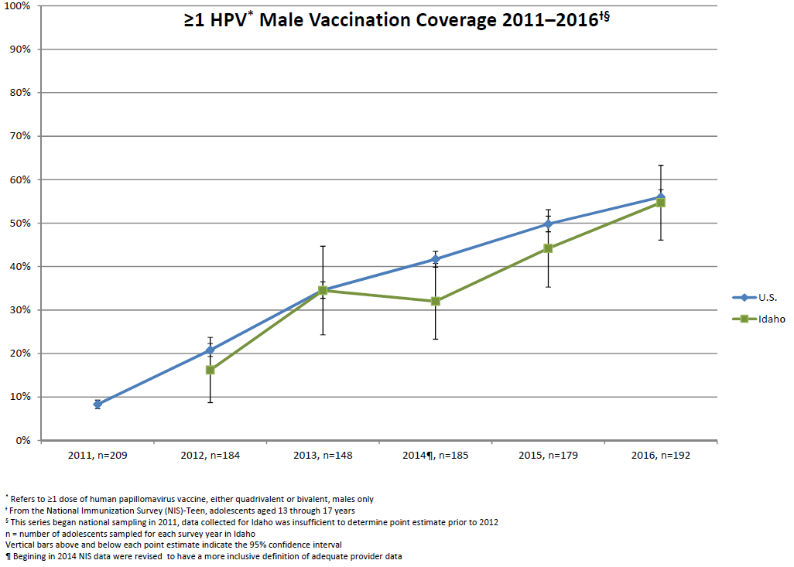
54.7%

Slide 14
Are there areas in the state where we are doing better than others?

Slide 15
Analysis of Idaho’s Immunization Reminder Information System (IRIS)
Carrie Sprague in IIP de-identified IRIS data:
Counts of 1+HPV, 2+HPV, and 3+HPV vaccine doses administered from 2014 - 2016
Included 13, 14, 15, 16, and 17 year olds
Chris Johnson in IHA used SAS software to read the data files and generate counts of HPV 1+, 2+ and 3+
Assigned each vaccination event to a county
Linked county-level counts to population denominator estimates from the National Center for Health Statistics to generate estimates of HPV vaccination coverage by county
Joe Pollard in the DPH mapped the findings

Slide 16
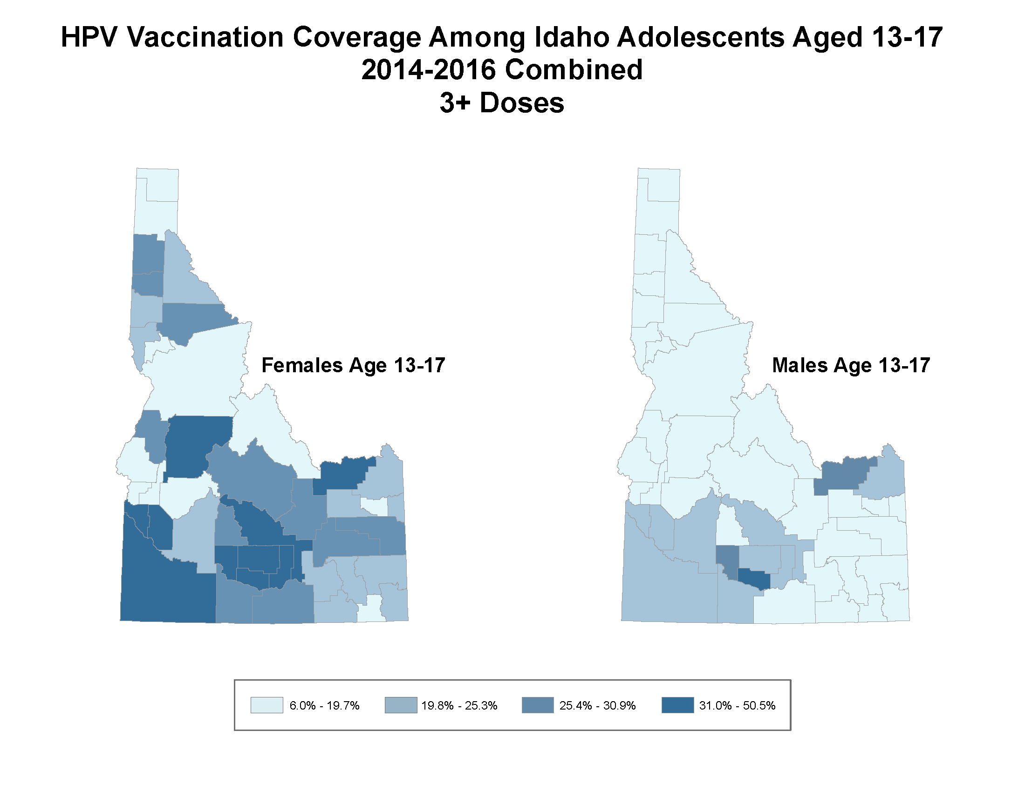
Kootenai/Benewah
Jerome

Slide 17
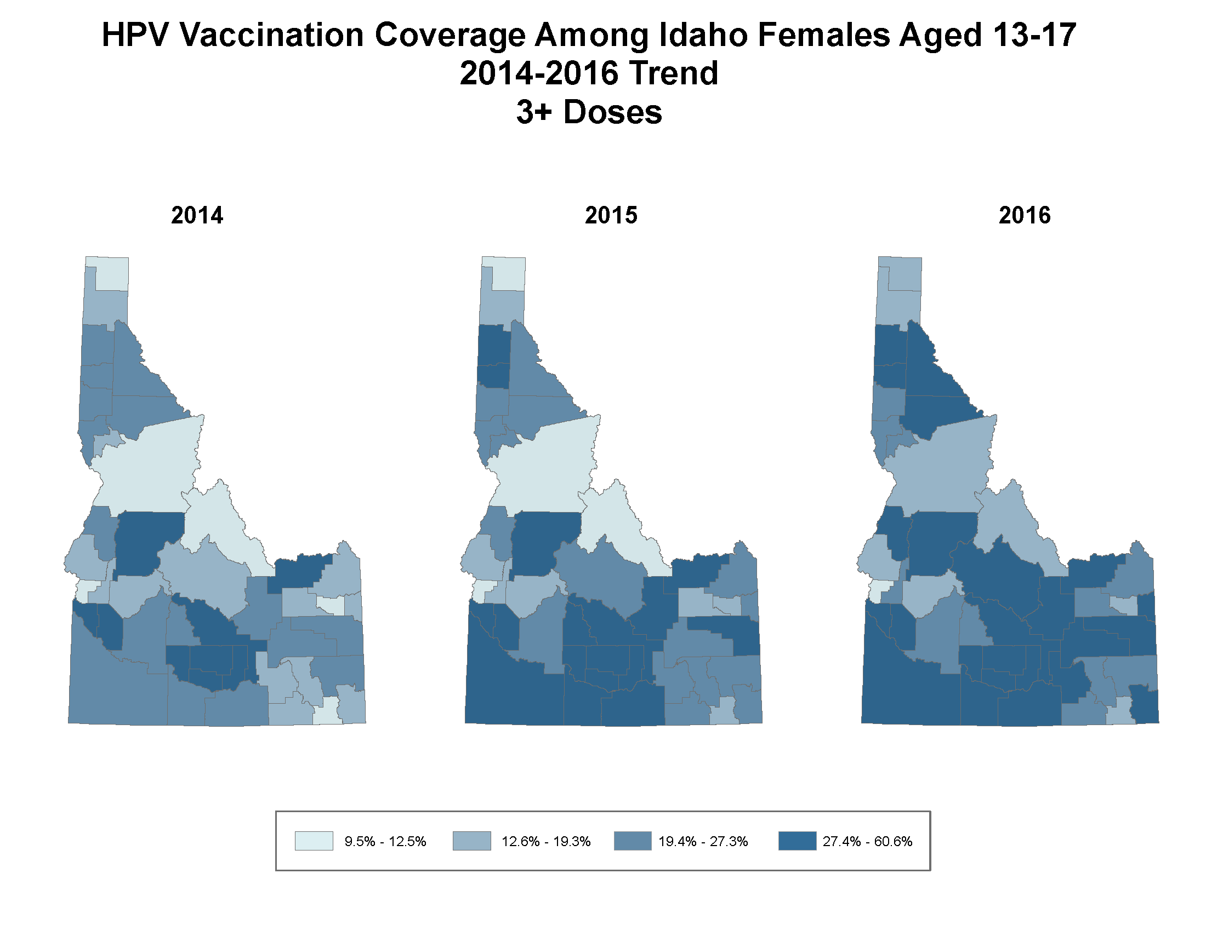

Slide 18
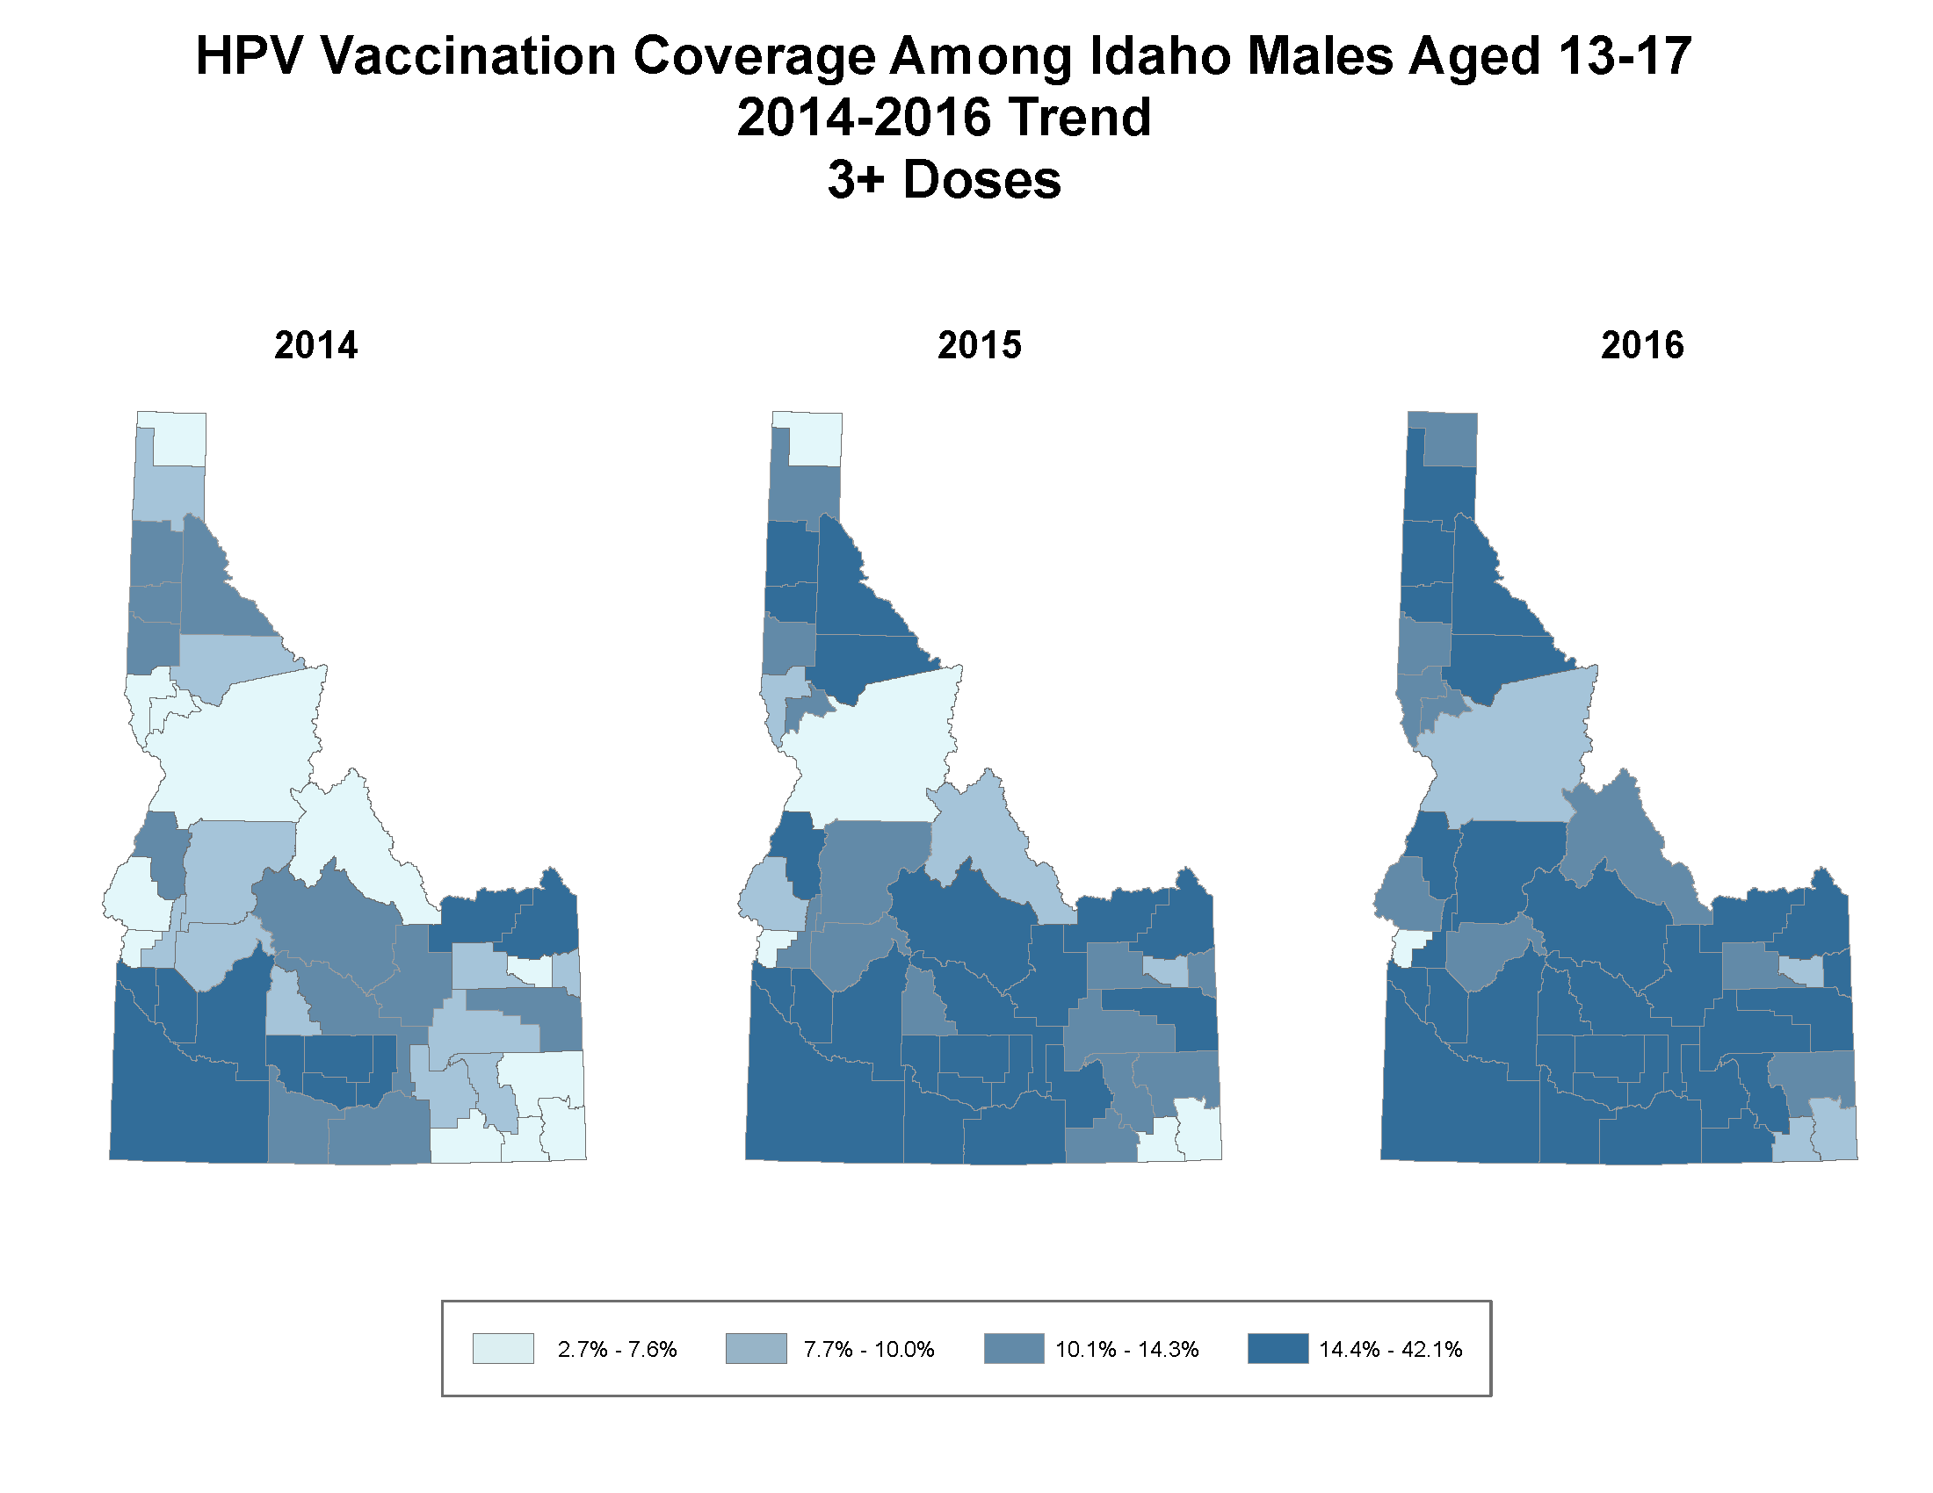
Payette

Slide 19
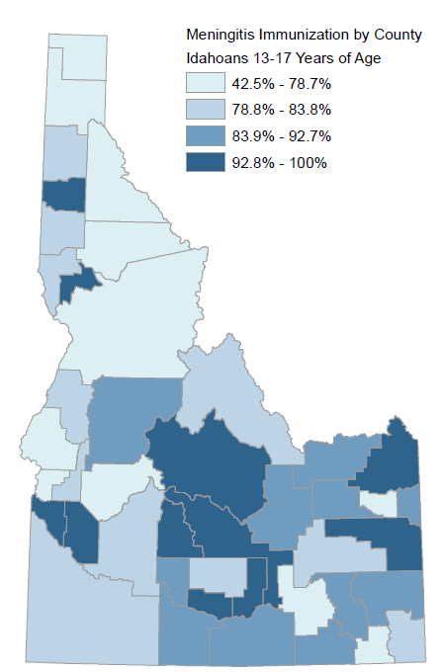
MenACWY-- ≥1 dose vaccination by county, Idaho-- 2016

Slide 20
Thank you!

Slide 21
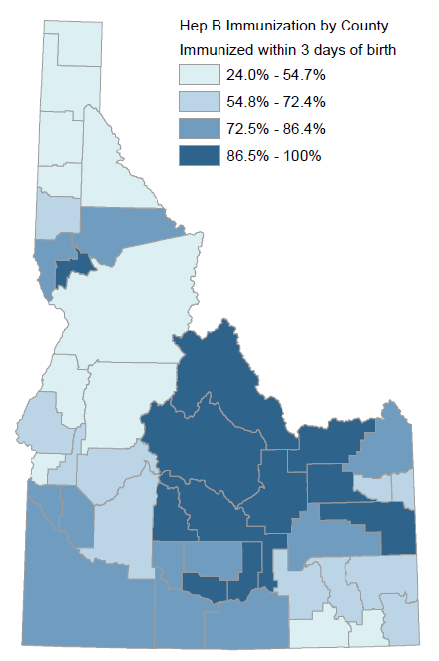
IRIS: rates of Hepatitis B birth dose immunization
Statewide: 76.0%

